Slide 1
Speedy Dungeon
Lucrative Ninjas

Slide 2
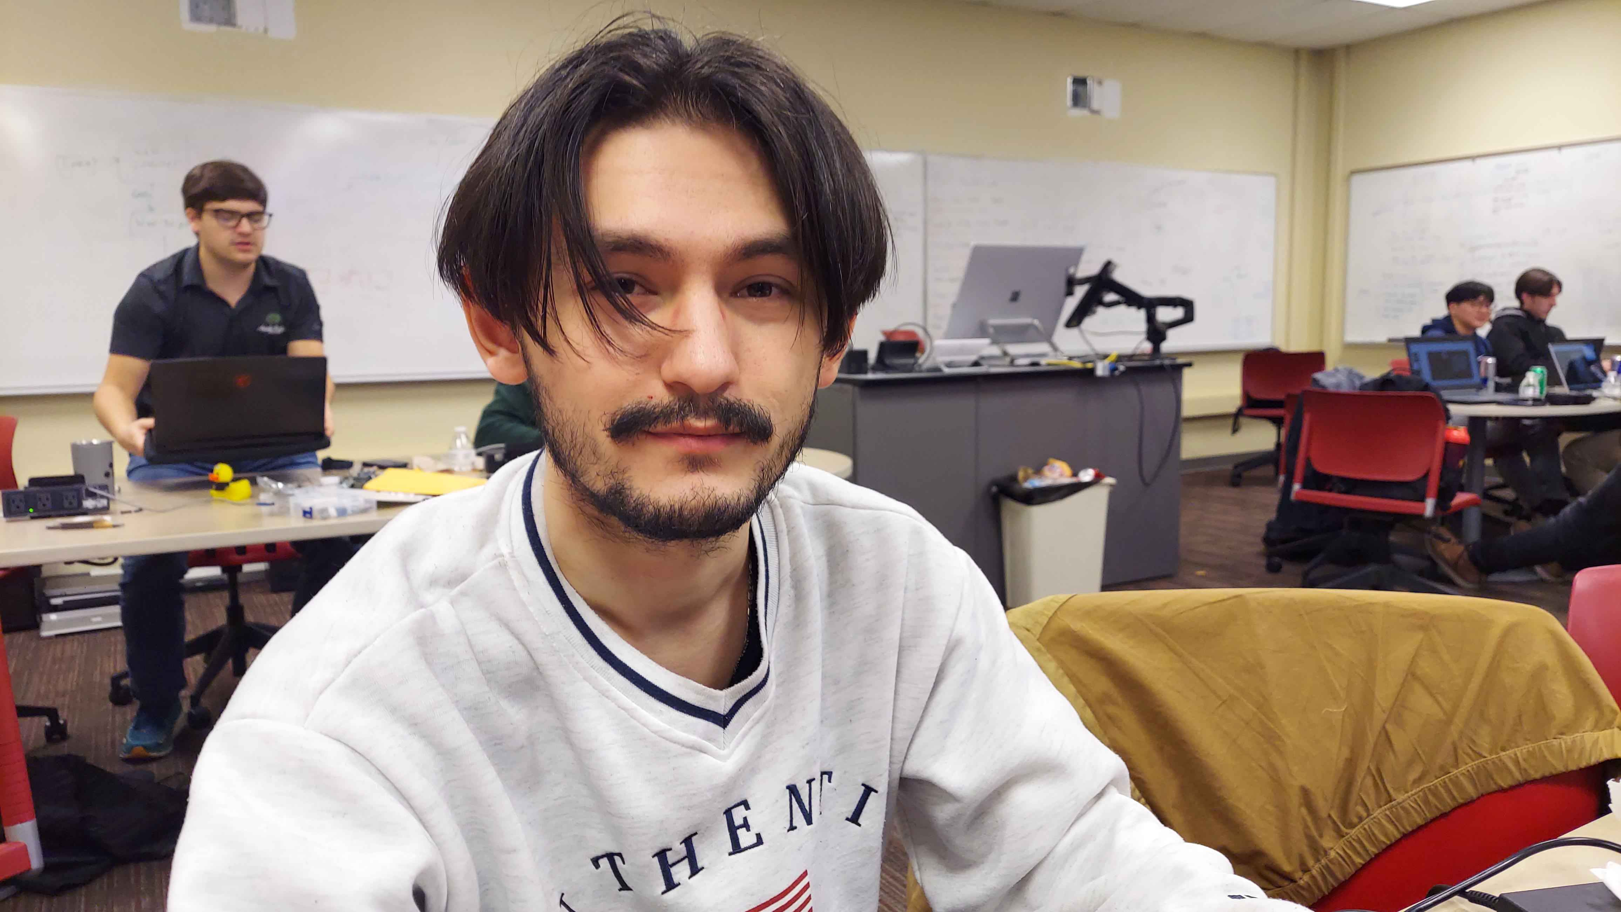
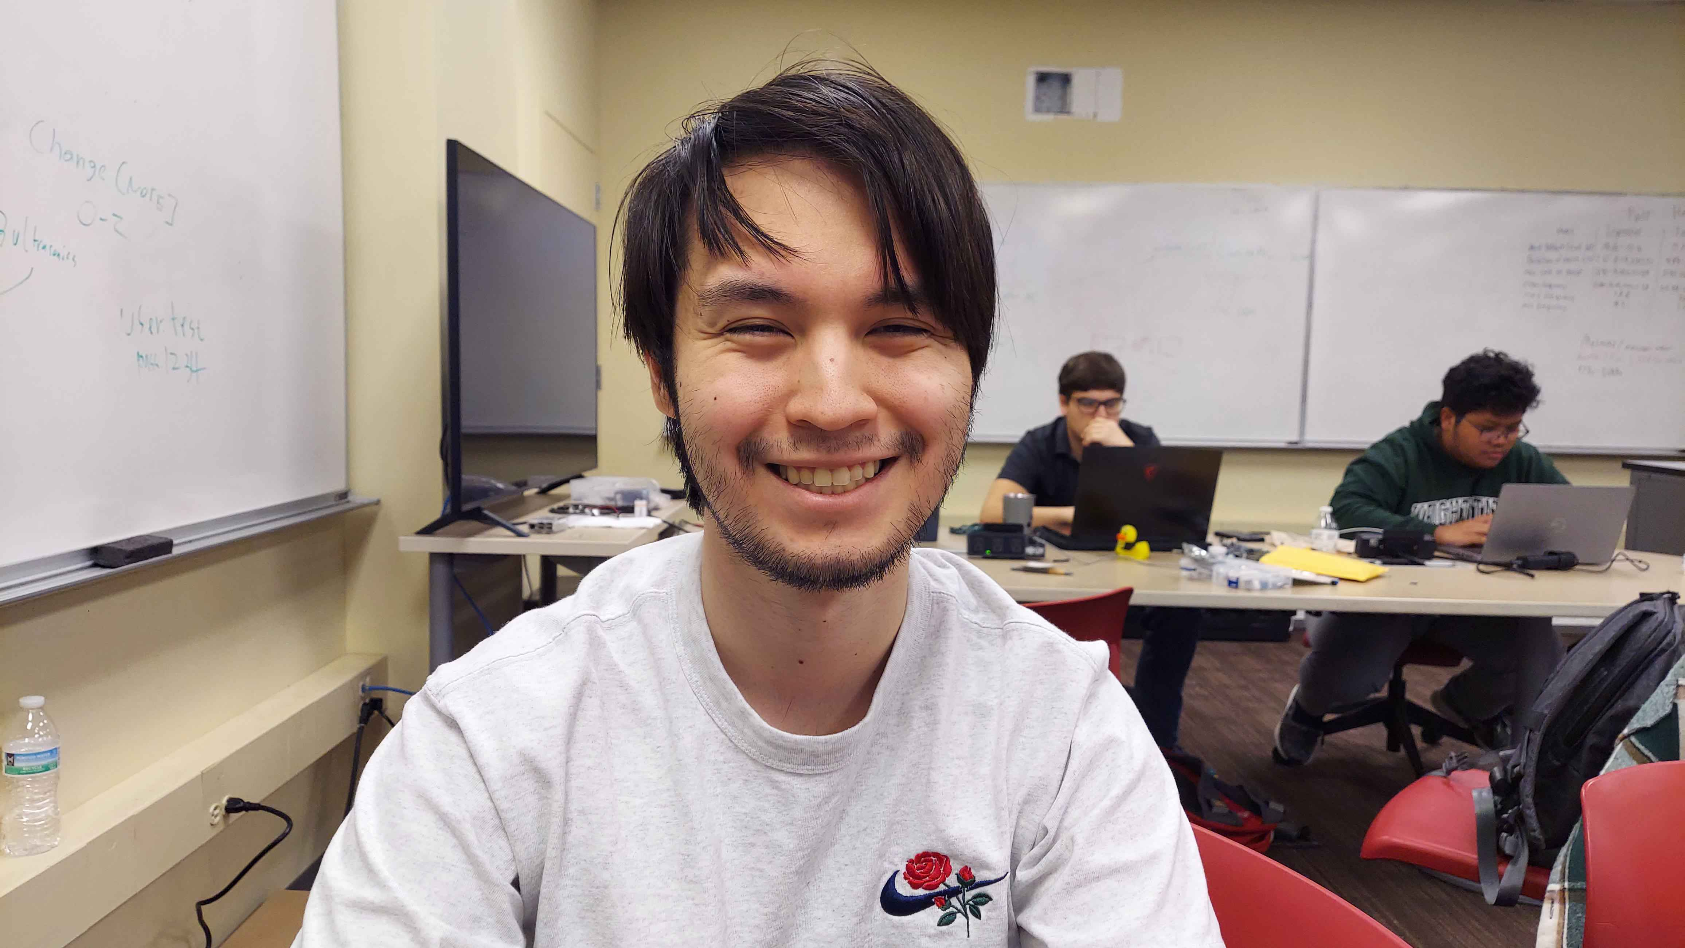
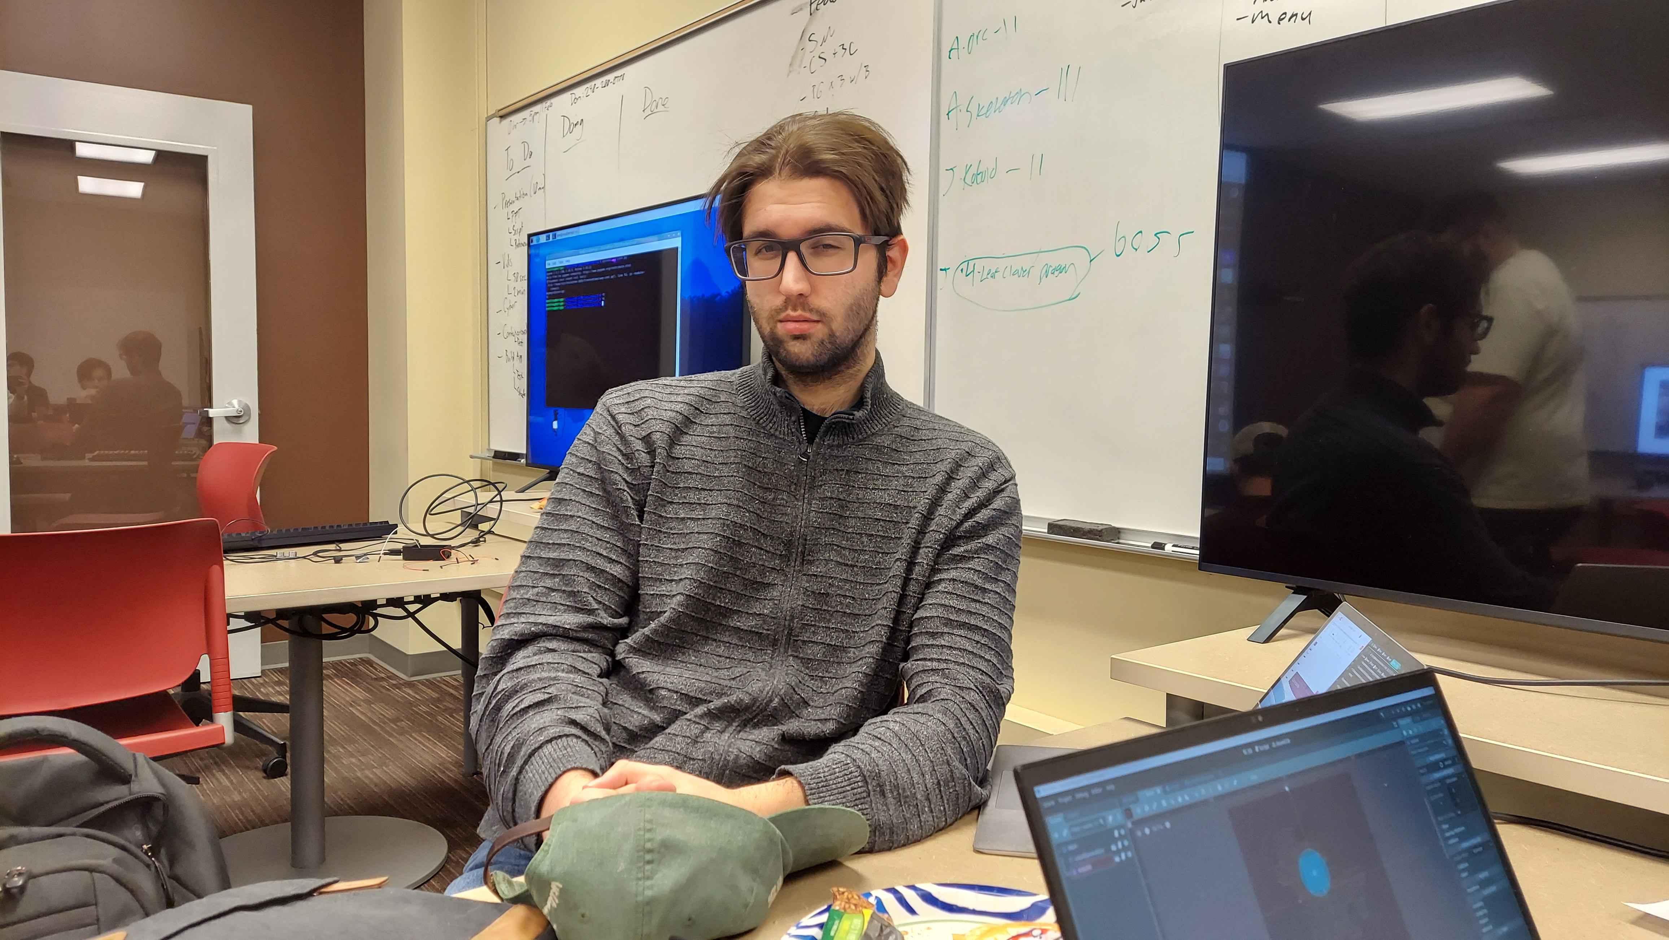
Lucrative Ninjas
Gani Sagiev
Jared Subr
Aidan McGohan
Shapiy Sagiev

Slide 3
Game Overview
Dungeon crawler
Room generation
Rewind mechanic
Speedrun

Slide 4

Challenges
Wanted to use Unity, but Docker compatibility problems
Limited documentation on Godot
Problems with Godot’s unique hierarchy
Unintentional miscommunication
2FA for Cyber
GitHub

Slide 5

What we’ve would’ve done with more time
More floors in the game
More bosses/mobs
Fleshed out classes with unique abilities
New mechanics

Slide 6
What we’ve learned
Communicate on merging branches
A lot can be done within 24 hours

Slide 7
Why we should win the Hackathon
Made functional game in an engine no one knows much about.
Created procedural generation

